Slide 1
Chapter 7
More SQL: Complex Queries

Slide 2
- More Complex SQL Retrieval Queries
- Views (Virtual Tables) in SQL
- Schema Change Statements in SQL
Content

Slide 3
More Complex SQL Retrieval Queries
Comparisons Involving NULL and Three-Valued Logic
NULL is used to represent a missing value, but it usually has one of three different interpretations:
  1. Value unknown (value exists but is not known, or it is not known whether or not the value exists)
  2. Value not available (value exists but is purposely withheld),
  3. Value not applicable (the attribute does not apply to this tuple or is undefined for this tuple).
Unknown value
A person’s date of birth is not known, so it is represented by NULL in the database.
An example of the other case of unknown would be NULL for a person’s home phone because it is not known whether or not the person has a home phone.
Unavailable or withheld value
A person has a home phone but does not want it to be listed, so it is withheld and represented as NULL in the database.
Not applicable attribute
An attribute Last College Degree would be NULL for a person who has no college degrees because it does not apply to that person.

Slide 4
More Complex SQL Retrieval Queries
Comparisons Involving NULL and Three-Valued Logic
When a record with NULL in one of its attributes is involved in a comparison operation, the result is considered to be UNKNOWN (it may be TRUE or it may be FALSE).
SQL uses a three-valued logic with values TRUE, FALSE, and UNKNOWN instead of the standard two-valued (Boolean) logic with values TRUE or FALSE.
It is therefore necessary to define the results (or truth values) of three-valued logical expressions when the logical connectives AND, OR, and NOT are used.

Slide 5
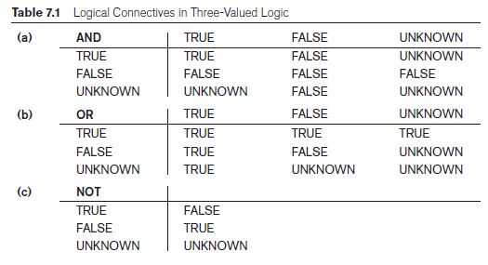
More Complex SQL Retrieval Queries
Comparisons Involving NULL and Three-Valued Logic

Slide 6
More Complex SQL Retrieval Queries
Comparisons Involving NULL and Three-Valued Logic
SQL allows queries that check whether an attribute value is NULL.
Rather than using = or <> to compare an attribute value to NULL, SQL uses the comparison operators “IS” or “IS NOT”.
This is because SQL considers each NULL value as being distinct from every other NULL value, so equality comparison is not appropriate.

Slide 7
More Complex SQL Retrieval Queries
Comparisons Involving NULL and Three-Valued Logic
Query 18. Retrieve the names of all employees who do not have supervisors.
Q18: SELECT Fname, Lname
FROM EMPLOYEE
WHERE Super_ssn IS NULL;

Slide 8
More Complex SQL Retrieval Queries
Subqueries
A Subquery or Inner query or a Nested query is a query within another SQL query and embedded within the WHERE clause.
Why use a subquery?
A subquery is used to return data that will be used in the main query as a condition to further restrict the data to be retrieved.
Subqueries can be used with the SELECT, FROM, WHERE, INSERT, UPDATE, and DELETE statements along with the operators like =, <, >, >=, <=, IN, ANY, SOME etc.
Subqueries must be enclosed within parentheses.
Subqueries that return more than one row can only be used with multiple value operators such as the IN operator.

Slide 9
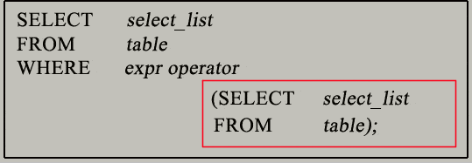
More Complex SQL Retrieval Queries
Subqueries
You can use a subquery in a SELECT, INSERT, DELETE, or UPDATE statement to perform the following tasks:
  Compare an expression to the result of the query.
  Determine if an expression is included in the results of the query.
The subquery (inner query) executes once before the main query (outer query) executes. Bottom – Top Approach
The main query (outer query) use the subquery result.

Slide 10
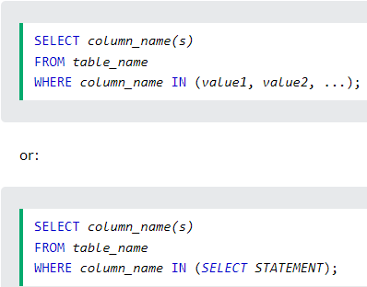
More Complex SQL Retrieval Queries
Nested Queries, Tuples, and Set/Multiset Comparisons
IN Operator
The comparison operator IN, which compares a value v with a set (or multiset) of values V and evaluates to TRUE if v is one of the elements in V.
The IN operator allows you to specify multiple values in a WHERE clause.
The IN operator is a shorthand for multiple OR conditions.

Slide 11
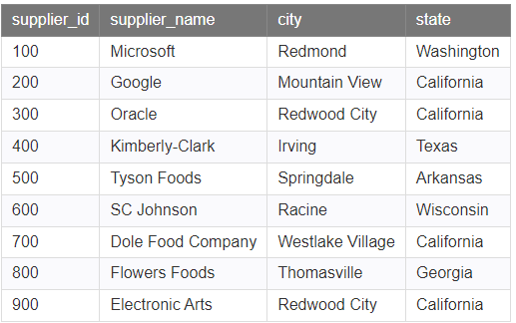
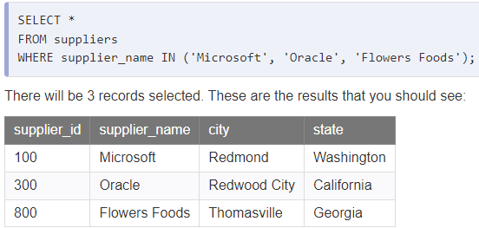
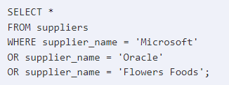
More Complex SQL Retrieval Queries
Nested Queries, Tuples, and Set/Multiset Comparisons
IN Operator

Slide 12
More Complex SQL Retrieval Queries
Nested Queries, Tuples, and Set/Multiset Comparisons
IN Operator
Query: Find the name of employees who are working on a project.
Select Eid From Project
Project Table | Project Table
Eid | Pid | Pname | Location
1 | P1 | IoT | Ohio
5 | P2 | AI | Los Angeles
3 | P3 | Cloud | Chicago
4 | P4 | Android | Texas
Employee Table | Employee Table
Eid | Ename | Address
1 | Brown | New York
2 | Sam | Houston
3 | Smith | Seattle
4 | John | Denver
5 | Mary | San Francisco

Slide 13
More Complex SQL Retrieval Queries
Nested Queries, Tuples, and Set/Multiset Comparisons
IN Operator
Query: Find the name of employees who are working on a project.
Select Ename
From Employee
Where Eid IN (Select Eid From Project )
Compare Eid from Employee table with Project Table. Check if that Eid exists IN Project Table.
Comparison is done one by one for the complete table.
Employee Table | Employee Table
Eid | Ename | Address
1 | Brown | New York
2 | Sam | Houston
3 | Smith | Seattle
4 | John | Denver
5 | Mary | San Francisco
Project Table | Project Table
Eid | Pid | Pname | Location
1 | P1 | IoT | Ohio
5 | P2 | AI | Los Angeles
3 | P3 | Cloud | Chicago
4 | P4 | Android | Texas

Slide 14
More Complex SQL Retrieval Queries
Nested Queries, Tuples, and Set/Multiset Comparisons
NOT IN Operator
Query: Find the name of employees who are not working on a project.
Select Ename
From Employee
Where Eid NOT IN (Select Eid From Project )
Compare Eid from Employee table with Project Table. Check if that Eid exists IN Project Table.
Comparison is done one by one for the complete table.
Employee Table | Employee Table
Eid | Ename | Address
1 | Brown | New York
2 | Sam | Houston
3 | Smith | Seattle
4 | John | Denver
5 | Mary | San Francisco
Project Table | Project Table
Eid | Pid | Pname | Location
1 | P1 | IoT | Ohio
5 | P2 | AI | Los Angeles
3 | P3 | Cloud | Chicago
4 | P4 | Android | Texas

Slide 15
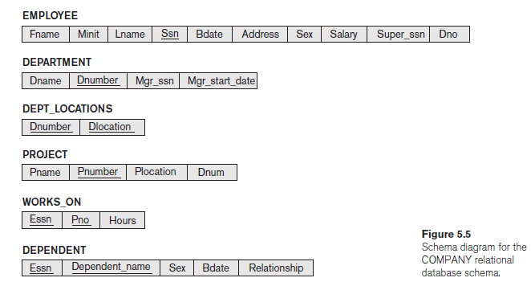
More Complex SQL Retrieval Queries
Nested Queries, Tuples, and Set/Multiset Comparisons
SQL allows the use of tuples of values in comparisons by placing them within parentheses.
Select the Essns of all employees who work the same (project, hours) combination on some project that employee ‘123456789’ works on.

Slide 16

More Complex SQL Retrieval Queries
Nested Queries, Tuples, and Set/Multiset Comparisons
In this example, the IN operator compares the subtuple of values in parentheses (Pno, Hours) within each tuple in WORKS_ON with the set of type-compatible tuples produced by the nested query.

Slide 17
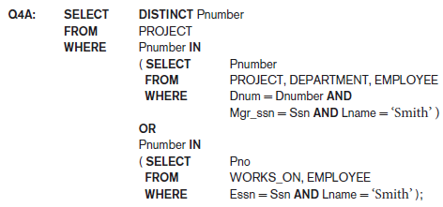
More Complex SQL Retrieval Queries
Nested Queries, Tuples, and Set/Multiset Comparisons
In Q4A:
the first nested query selects the project numbers of projects that have an employee with last name ‘Smith’ involved as manager,
whereas the second nested query selects the project numbers of projects that have an employee with last name ‘Smith’ involved as worker.
In the outer query, we use the OR logical connective to retrieve a PROJECT tuple if the PNUMBER value of that tuple is in the result of either nested query.

Slide 18
More Complex SQL Retrieval Queries
Nested Queries, Tuples, and Set/Multiset Comparisons
If a nested query returns a single attribute and a single tuple, the query result will be a single (scalar) value.
In such cases, it is permissible to use = instead of IN for the comparison operator.

Slide 19
More Complex SQL Retrieval Queries
Nested Queries, Tuples, and Set/Multiset Comparisons
A number of other comparison operators can be used to compare a single value v (typically an attribute name) to a set or multiset v (typically a nested query).
The = ANY (or = SOME) operator returns TRUE if the value v is equal to some value in the set V and is hence equivalent to IN.
Other operators that can be combined with ANY (or SOME) include >, >=, <, <=, and <>.

Slide 20
More Complex SQL Retrieval Queries
Nested Queries, Tuples, and Set/Multiset Comparisons
The keyword ALL can also be combined with each of these operators.
For example, the comparison condition (v > ALL V) returns TRUE if the value v is greater than all the values in the set (or multiset) V.
Return the names of employees whose salary is greater than the salary of all the employees in department 5.

Slide 21
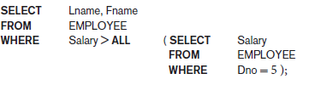
More Complex SQL Retrieval Queries
Nested Queries, Tuples, and Set/Multiset Comparisons
Return the names of employees whose salary is greater than the salary of all the employees in department 5.

Slide 22
More Complex SQL Retrieval Queries
Nested Queries, Tuples, and Set/Multiset Comparisons
AMBIGUITY ISSUE
  Ambiguity among attribute names if attributes of the same name exist—one in a relation in the FROM clause of the outer query, and another in a relation in the FROM clause of the nested query.
To refer to an attribute of the relation specified in the outer query, we specify and refer to an alias (tuple variable) for that relation.

Slide 23
More Complex SQL Retrieval Queries
Nested Queries, Tuples, and Set/Multiset Comparisons
Retrieve the name of each employee who has a dependent with the same first name and is the same sex as the employee.

Slide 24
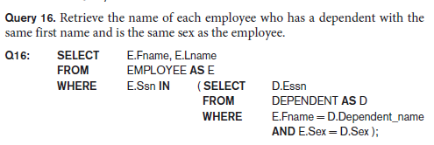
More Complex SQL Retrieval Queries
Nested Queries, Tuples, and Set/Multiset Comparisons
AMBIGUITY ISSUE
In the nested query of Q16, we must qualify E.Sex because it refers to the Sex attribute of EMPLOYEE from the outer query, and DEPENDENT also has an attribute called Sex.
If there were any unqualified references to Sex in the nested query, they would refer to the Sex attribute of DEPENDENT.
However, we would not have to qualify the attributes Fname and Ssn of EMPLOYEE if they appeared in the nested query because the DEPENDENT relation does not have attributes called Fname and Ssn, so there is no ambiguity.

Slide 25
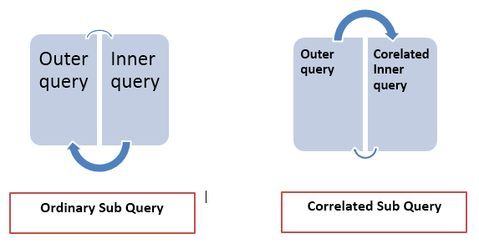
More Complex SQL Retrieval Queries
Correlated Nested Queries
Correlated subqueries are used for row-by-row processing.
Each subquery is executed once for every row of the outer query.
The parent statement can be a SELECT, UPDATE, or DELETE statement.

Slide 26
More Complex SQL Retrieval Queries
Correlated Nested Queries
A correlated subquery is one way of reading every row in a table and comparing values in each row against related data.
Nested Subqueries Versus Correlated Subqueries :
With a normal nested subquery, the inner SELECT query runs first and executes once, returning values to be used by the main query. A correlated subquery, however, executes once for each candidate row considered by the outer query. In other words, the inner query is driven by the outer query.
NOTE : You can also use the ANY and ALL operator in a correlated subquery.

Slide 27

More Complex SQL Retrieval Queries
Correlated Nested Queries
Whenever a condition in the WHERE clause of a nested query references some attribute of a relation declared in the outer query, the two queries are said to be correlated.
For example, we can think of Q16 as follows:
For each EMPLOYEE tuple, evaluate the nested query, which retrieves the Essn values for all DEPENDENT tuples with the same sex and name as that EMPLOYEE tuple; if the Ssn value of the EMPLOYEE tuple is in the result of the nested query, then select that EMPLOYEE tuple.

Slide 28
More Complex SQL Retrieval Queries
The EXISTS Function in SQL
EXISTS is a Boolean functions that return TRUE or FALSE.
Can be used in a WHERE clause condition.
EXISTS function: used to check whether the result of a nested query is empty (contains no tuples) or not.
The result of EXISTS is a Boolean value TRUE if the nested query result contains at least one tuple, or FALSE if the nested query result contains no tuples.
EXISTS and NOT EXISTS are typically used in conjunction with a correlated nested query.

Slide 29
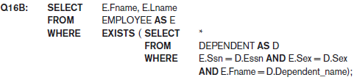
More Complex SQL Retrieval Queries
The EXISTS Function in SQL
In Q16B, the nested query references the Ssn, Fname, and Sex attributes of the EMPLOYEE relation from the outer query.
For each EMPLOYEE tuple, evaluate the nested query, which retrieves all DEPENDENT tuples with the same Essn, Sex, and Dependent_name as the EMPLOYEE tuple; if at least one tuple EXISTS in the result of the nested query, then select that EMPLOYEE tuple.
EXISTS(Q) returns TRUE if there is at least one tuple in the result of the nested query, and returns FALSE otherwise.

Slide 30
More Complex SQL Retrieval Queries
The EXISTS Function in SQL
NOT EXISTS(Q) returns TRUE if there are no tuples in the result of nested query Q, and returns FALSE otherwise.
Retrieve the names of employees with no dependents.

Slide 31
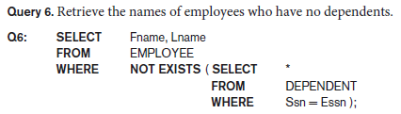
More Complex SQL Retrieval Queries
The EXISTS Function in SQL
In Q6, the correlated nested query retrieves all DEPENDENT tuples related to a particular EMPLOYEE tuple.
If none exist, the EMPLOYEE tuple is selected because the WHERE-clause condition will evaluate to TRUE in this case.
Q6 as follows: For each EMPLOYEE tuple, the correlated nested query selects all DEPENDENT tuples whose Essn value matches the EMPLOYEE Ssn; if the result is empty, no dependents are related to the employee, so we select that EMPLOYEE tuple and retrieve its Fname and Lname.

Slide 32
More Complex SQL Retrieval Queries
The EXISTS Function in SQL
List the names of managers who have atleast one dependent.

Slide 33
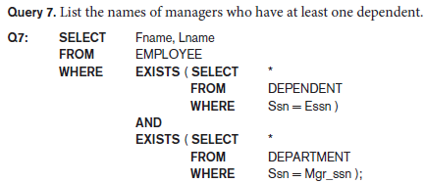
More Complex SQL Retrieval Queries
The EXISTS Function in SQL
One way to write this query is shown in Q7, where we specify two nested correlated queries.
The first selects all DEPENDENT tuples related to an EMPLOYEE, and the second selects all DEPARTMENT tuples managed by the EMPLOYEE.
If at least one of the first and at least one of the second exists, we select the EMPLOYEE tuple.

Slide 34
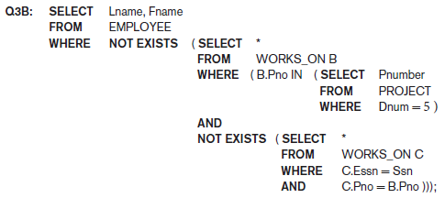
More Complex SQL Retrieval Queries
The EXISTS Function in SQL
In Q3B, the outer nested query selects any WORKS_ON (B) tuples whose Pno is of a project controlled by department 5, if there is not a WORKS_ON (C) tuple with the same Pno and the same Ssn as that of the EMPLOYEE tuple under consideration in the outer query.
If no such tuple exists, we select the EMPLOYEE tuple.
The form of Q3B matches the following rephrasing of Query 3: Select each employee such that there does not exist a project controlled by department 5 that the employee does not work on.
A given employee with Essn does not work in atleast one project controlled by dept 5.

Slide 35
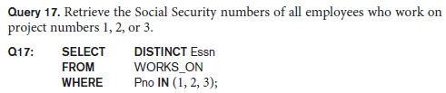

More Complex SQL Retrieval Queries
Explicit Sets and Renaming in SQL
It is also possible to use an explicit set of values in the WHERE clause, rather than a nested query. Such a set is enclosed in parentheses in SQL.
In SQL, it is possible to rename any attribute that appears in the result of a query by adding the qualifier AS followed by the desired new name.
Hence, the AS construct can be used to alias both attribute and relation names in general, and it can be used in appropriate parts of a query.

Slide 36

More Complex SQL Retrieval Queries
Joined Tables in SQL and Outer Joins
The concept of a joined table (or joined relation) was incorporated into SQL to permit users to specify a table resulting from a join operation in the FROM clause of a query.
For example, consider query, which retrieves the name and address of every employee who works for the ‘Research’ department. It may be easier to specify the join of the EMPLOYEE and DEPARTMENT relations in the WHERE clause, and then to select the desired tuples and attributes.
The FROM clause in Q1A contains a single joined table. The attributes of such a table are all the attributes of the first table, EMPLOYEE, followed by all the attributes of the second table, DEPARTMENT.
The concept of a joined table also allows the user to specify different types of join, such as NATURAL JOIN and various types of OUTER JOIN. In a NATURAL JOIN on two relations R and S, no join condition is specified.

Slide 37
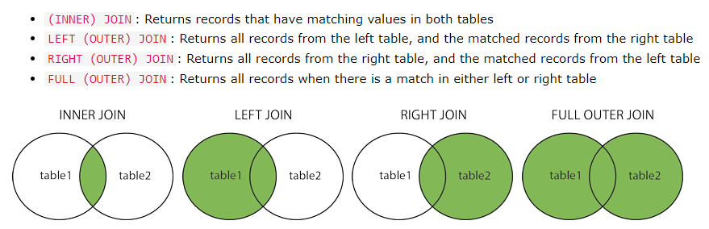
More Complex SQL Retrieval Queries
Joined Tables in SQL and Outer Joins

Slide 38
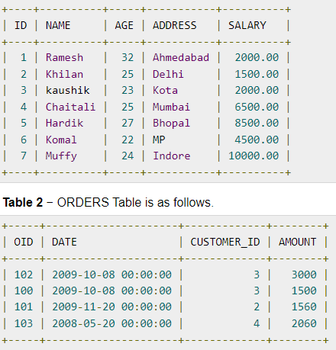
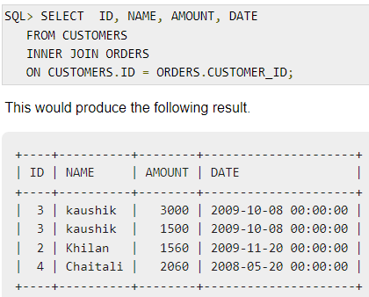
More Complex SQL Retrieval Queries
Joined Tables in SQL and Outer Joins – INNER JOIN

Slide 39
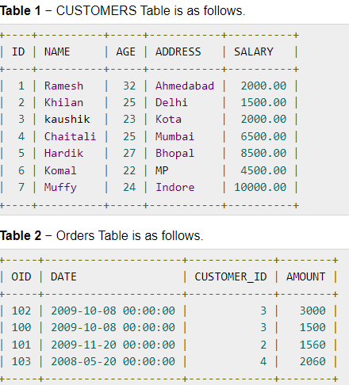
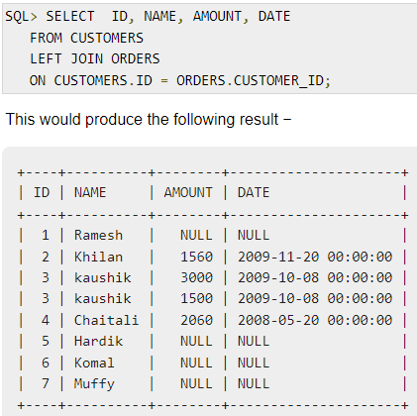
More Complex SQL Retrieval Queries
Joined Tables in SQL and Outer Joins – LEFT JOIN

Slide 40
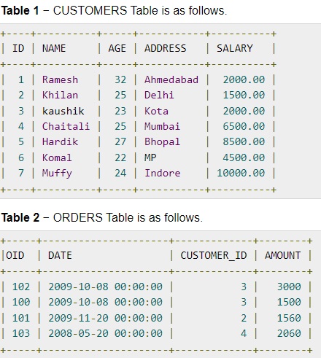
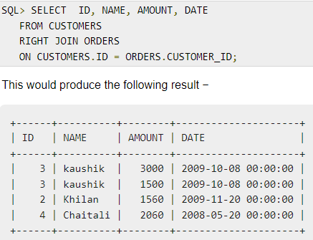
More Complex SQL Retrieval Queries
Joined Tables in SQL and Outer Joins – RIGHT JOIN

Slide 41
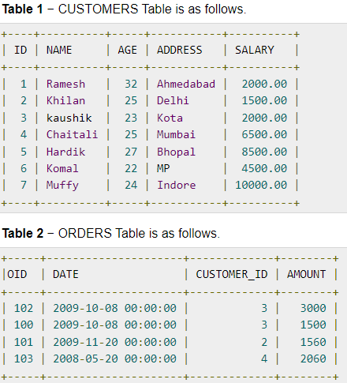
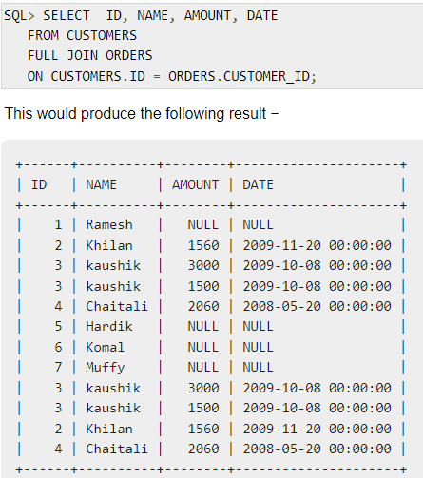
More Complex SQL Retrieval Queries
Joined Tables in SQL and Outer Joins – FULL JOIN

Slide 42
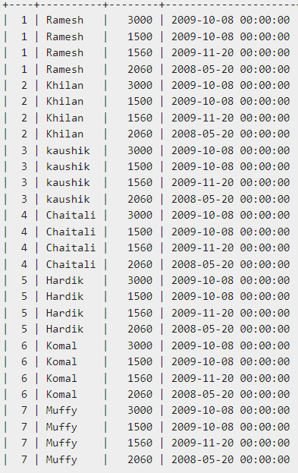
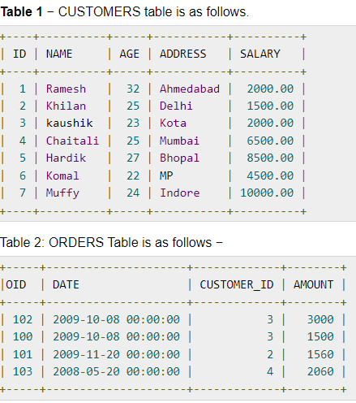

More Complex SQL Retrieval Queries
Joined Tables in SQL and Outer Joins – CROSS JOIN

Slide 43
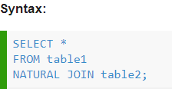
More Complex SQL Retrieval Queries
Joined Tables in SQL and Outer Joins – NATURAL JOIN
- The associated tables have one or more pairs of identically named columns.
- The columns must be the same data type.
- Don’t use ON clause in a natural join.

Slide 44
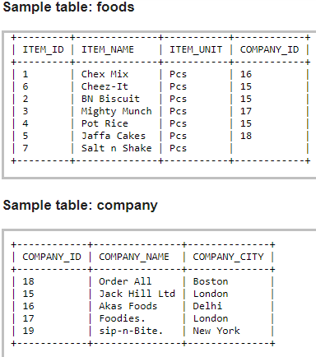

More Complex SQL Retrieval Queries
Joined Tables in SQL and Outer Joins – NATURAL JOIN

Slide 45
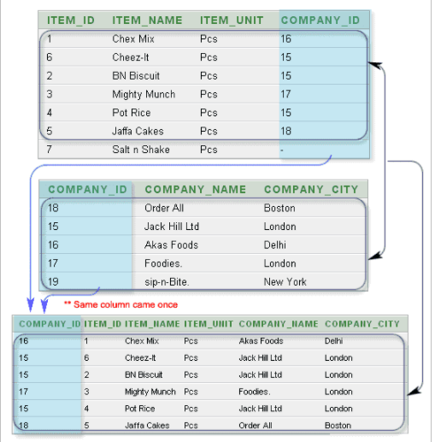
More Complex SQL Retrieval Queries
Joined Tables in SQL and Outer Joins – NATURAL JOIN

Slide 46

More Complex SQL Retrieval Queries
Joined Tables in SQL and Outer Joins
If the names of the join attributes are not the same in the base relations, it is possible to rename the attributes so that they match, and then to apply NATURAL JOIN.
In this case, the AS construct can be used to rename a relation and all its attributes in the FROM clause.
This is illustrated in Q1B, where the DEPARTMENT relation is renamed as DEPT and its attributes are renamed as Dname, Dno (to match the name of the desired join attribute Dno in the EMPLOYEE table), Mssn, and Msdate.
The implied join condition for this NATURAL JOIN is EMPLOYEE.Dno = DEPT.Dno, because this is the only pair of attributes with the same name after renaming:

Slide 47
More Complex SQL Retrieval Queries
Joined Tables in SQL and Outer Joins
The default type of join in a joined table is called an inner join, where a tuple is included in the result only if a matching tuple exists in the other relation.
In SQL, the options available for specifying joined tables include:
  INNER JOIN (only pairs of tuples that match the join condition are retrieved, same as JOIN),
  LEFT OUTER JOIN (every tuple in the left table must appear in the result; if it does not have a matching tuple, it is padded with NULL values for the attributes of the right table),
  RIGHT OUTER JOIN (every tuple in the right table must appear in the result; if it does not have a matching tuple, it is padded with NULL values for the attributes of the lefttable), and FULL OUTER JOIN. In the latter three options, the keyword OUTER may be omitted.
  If the join attributes have the same name, one can also specify the natural join variation of outer joins by using the keyword NATURAL before the operation (for example, NATURAL LEFT OUTER JOIN).
  The keyword CROSS JOIN is used to specify the CARTESIAN PRODUCT although this should be used only with the utmost care because it generates all possible tuple combinations.

Slide 48

More Complex SQL Retrieval Queries
Joined Tables in SQL and Outer Joins
It is also possible to nest join specifications; that is, one of the tables in a join may itself be a joined table.
This allows the specification of the join of three or more tables as a single joined table, which is called a multiway join.
For example, Q2A is a different way of specifying query Q2 from Section 6.3.1 using the concept of a joined table:

Slide 49

More Complex SQL Retrieval Queries
Aggregate Functions in SQL
Aggregate functions are used to summarize information from multiple tuples into a single-tuple summary.
Grouping is used to create subgroups of tuples before summarization.
A number of built-in aggregate functions exist: COUNT, SUM, MAX, MIN, and AVG.
  The COUNT function returns the number of tuples or values as specified in a query.
  The functions SUM, MAX, MIN, and AVG can be applied to a set or multiset of numeric values and return, respectively, the sum, maximum value, minimum value, and average (mean) of those values.

Slide 50

More Complex SQL Retrieval Queries
Aggregate Functions in SQL
We could use AS to rename the column names in the resulting single-row table; for example, as in Q19A.

Slide 51
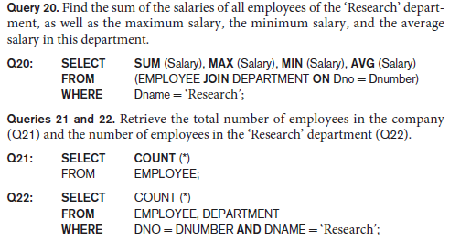
More Complex SQL Retrieval Queries
Aggregate Functions in SQL
If we want to get the preceding aggregate function values for employees of a specific department—say, the ‘Research’ department—we can write Query 20, where the EMPLOYEE tuples are restricted by the WHERE clause to those employees who work for the ‘Research’ department.
Here the asterisk (*) refers to the rows (tuples), so COUNT (*) returns the number of
rows in the result of the query. This includes NULL values and duplicates.

Slide 52

More Complex SQL Retrieval Queries
Aggregate Functions in SQL
We may also use the COUNT function to count values in a column rather than tuples.
If we write COUNT(SALARY) instead of COUNT(DISTINCT SALARY) in Q23, then duplicate values will not be eliminated.
However, any tuples with NULL for SALARY will not be counted.
COUNT(expression) does not count NULL values. It can optionally count or not count duplicate field values.

Slide 53
More Complex SQL Retrieval Queries
Aggregate Functions in SQL
MAX and MIN do not count NULL in their evaluation of data. If we have a column containing only dates for instance and there is a NULL date, MAX and MIN will both ignore that value.
Aggregate functions such as SUM, COUNT, AVG, MAX, and MIN exclude NULL values.
In general, NULL values are discarded when aggregate functions are applied to a particular column (attribute); the only exception is for COUNT(*) because tuples instead of values are counted.
The general rule is as follows: when an aggregate function is applied to a collection of values, NULLs are removed from the collection before the calculation; if the collection becomes empty because all values are NULL, the aggregate function will return NULL (except in the case of COUNT, where it will return 0 for an empty collection of values).

Slide 54
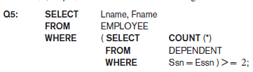
More Complex SQL Retrieval Queries
Aggregate Functions in SQL
We can specify a correlated nested query with an aggregate function, and then use the nested query in the WHERE clause of an outer query.
For example, to retrieve the names of all employees who have two or more dependents (Query 5), we can write the following:
The correlated nested query counts the number of dependents that each employee has; if this is greater than or equal to two, the employee tuple is selected.
SQL also has aggregate functions SOME and ALL that can be applied to a collection of Boolean values; SOME returns TRUE if at least one element in the collection is TRUE, whereas ALL returns TRUE if all elements in the collection are TRUE.

Slide 55
More Complex SQL Retrieval Queries
Grouping: The GROUP BY and HAVING Clauses
In many cases we want to apply the aggregate functions to subgroups of tuples in a relation, where the subgroups are based on some attribute values.
  For example, we may want to find the average salary of employees in each department or the number of employees who work on each project.
In these cases, we need to partition the relation into subsets (or groups) of tuples.
Each group (partition) will consist of the tuples that have the same value of some attribute(s), called the grouping attribute(s).
We can then apply the function to each such group independently to produce summary information about each group.

Slide 56
More Complex SQL Retrieval Queries
Grouping: The GROUP BY and HAVING Clauses
The GROUP BY clause specifies the grouping attributes, which should also appear in the SELECT clause, so that the value resulting from applying each aggregate function to a group of tuples appears along with the value of the grouping attribute(s).
The GROUP BY statement is often used with aggregate functions (COUNT(), MAX(), MIN(), SUM(), AVG()) to group the result-set by one or more columns.
GROUP BY clause in the SELECT statement without using aggregate functions, it would behave like DISTINCT clause.

Slide 57
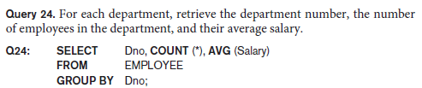
More Complex SQL Retrieval Queries
Grouping: The GROUP BY and HAVING Clauses
In Q24, the EMPLOYEE tuples are partitioned into groups—each group having the same value for the GROUP BY attribute Dno.
Hence, each group contains the employees who work in the same department. The COUNT and AVG functions are applied to each such group of tuples.
The SELECT clause includes only the grouping attribute and the aggregate functions to be applied on each group of tuples.

Slide 58
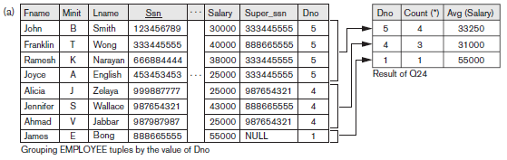
More Complex SQL Retrieval Queries
Grouping: The GROUP BY and HAVING Clauses

Slide 59
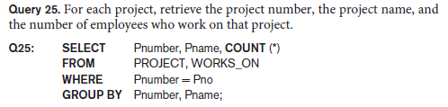
More Complex SQL Retrieval Queries
Grouping: The GROUP BY and HAVING Clauses
If NULLs exist in the grouping attribute, then a separate group is created for all tuples with a NULL value in the grouping attribute.
For example, if the EMPLOYEE table had some tuples that had NULL for the grouping attribute Dno, there would be a separate group for those tuples in the result of Q24.
Q25 shows how we can use a join condition in conjunction with GROUP BY.
In this case, the grouping and functions are applied after the joining of the two relations in the WHERE clause.

Slide 60
More Complex SQL Retrieval Queries
Grouping: The GROUP BY and HAVING Clauses

Slide 61
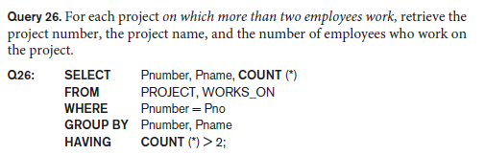
More Complex SQL Retrieval Queries
Grouping: The GROUP BY and HAVING Clauses
SQL provides a HAVING clause, which can appear in conjunction with a GROUP BY clause.
HAVING provides a condition on the summary information regarding the group of tuples associated with each value of the grouping attributes.
The HAVING clause was added to SQL because the WHERE keyword cannot be used with aggregate functions.
Only the groups that satisfy the condition are retrieved in the result of the query. This is illustrated by Query 26.

Slide 62
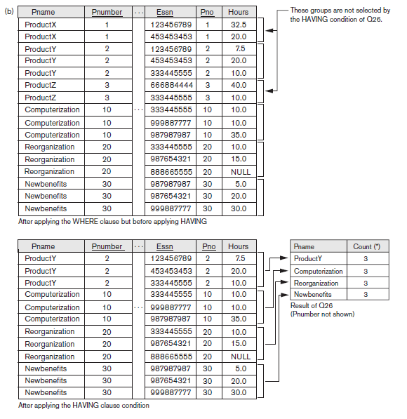
More Complex SQL Retrieval Queries

Slide 63
More Complex SQL Retrieval Queries
Grouping: The GROUP BY and HAVING Clauses
In Q27, we restrict the tuples in the relation (and hence the tuples in each group) to those that satisfy the condition specified in the WHERE clause—namely, that they work in department number 5.
Notice that we must be extra careful when two different conditions apply (one to the aggregate function in the SELECT clause and another to the function in the HAVING clause).
For example, suppose that we want to count the total number of employees whose salaries exceed $40,000 in each department, but only for departments where more than five employees work.
Here, the condition (SALARY > 40000) applies only to the COUNT function in the SELECT clause.

Slide 64

More Complex SQL Retrieval Queries
Grouping: The GROUP BY and HAVING Clauses
Suppose that we write the following incorrect query:
This is incorrect because it will select only departments that have more than five employees who each earn more than $40,000.
The rule is that the WHERE clause is executed first, to select individual tuples or joined tuples; the HAVING clause is applied later, to select individual groups of tuples.
In the incorrect query, the tuples are already restricted to employees who earn more than $40,000 before the function in the HAVING clause is applied.

Slide 65

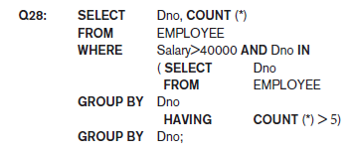
More Complex SQL Retrieval Queries
Grouping: The GROUP BY and HAVING Clauses
One way to write this query correctly is to use a nested query, as shown in Query 28.

Slide 66
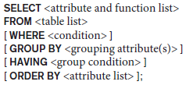
More Complex SQL Retrieval Queries
Discussion and Summary of SQL Queries
A retrieval query in SQL can consist of up to six clauses, but only the first two— SELECT and FROM—are mandatory.
The query can span several lines, and is ended by a semicolon.
Query terms are separated by spaces, and parentheses can be used to group relevant parts of a query in the standard way.
The clauses are specified in the following order, with the clauses between square brackets [ … ] being optional:

Slide 67
More Complex SQL Retrieval Queries
Discussion and Summary of SQL Queries
The SELECT clause lists the attributes or functions to be retrieved.
The FROM clause specifies all relations (tables) needed in the query, including joined relations, but not those in nested queries.
The WHERE clause specifies the conditions for selecting the tuples from these relations, including join conditions if needed.
GROUP BY specifies grouping attributes, whereas HAVING specifies a condition on the groups being selected rather than on the individual tuples.
The built-in aggregate functions COUNT, SUM, MIN, MAX, and AVG are used in conjunction with grouping, but they can also be applied to all the selected tuples in a query without a GROUP BY clause.
Finally, ORDER BY specifies an order for displaying the result of a query.

Slide 68
More Complex SQL Retrieval Queries
Discussion and Summary of SQL Queries
A query is evaluated conceptually by first applying the FROM clause (to identify all tables involved in the query or to materialize any joined tables), followed by the WHERE clause to select and join tuples, and then by GROUP BY and HAVING.
Conceptually, ORDER BY is applied at the end to sort the query result.
If none of the last three clauses (GROUP BY, HAVING, and ORDER BY) are specified, we can think conceptually of a query as being executed as follows:
For each combination of tuples—one from each of the relations specified in the FROM clause—evaluate the WHERE clause; if it evaluates to TRUE, place the values of the attributes specified in the SELECT clause from this tuple combination in the result of the query.

